Slide 1

Analysis of SurveyMonkey Text Responses to National Brain Tumor Society’s Brain Tumor Patient and Caregiver Clinical Trial Attitudes Survey
By: Amanda Bates
Regis University
March 2018

Slide 2
Background
I work for the National Brain Tumor Society as the Research Programs Manager. A part of my job is to lead our Patient and Caregiver Engagement Program, which we started by surveying patients and caregivers about if, when, and how they were informed about clinical trials and their attitudes towards clinical trials

Slide 3
Project motivation
Many of the questions asked in the National Brain Tumor Society’s Brain Tumor Patient and Caregiver Clinical Trial Attitudes Survey allowed for an option of “Other (please specify)”
The information captured in the “Other” responses was not as easy to analyze as the multiple choice responses, but still as valuable, if not more so
I wanted to use Machine Learning to determine if there were any patterns or clusters within the responses provided in order to glean insights into what may motivate more brain tumor patients to participate in clinical trials

Slide 4
The data
The survey was conducted using SurveyMonkey
Based on their responses to certain questions, participants were placed into one of 6 arms
Newly diagnosed patient
Recurrent patient
Metastatic patient
Newly diagnosed caregiver
Recurrent Caregiver
Metastatic caregiver
There were 1675 partial responses, with 1463 complete responses.
46% of respondents were patients, 54% were caregivers

Slide 5
The data
The three most prevalent brain tumor types reported by respondents were glioblastoma, meningioma, and astrocytoma
21% of all patients surveyed participated in a clinical trials for a brain tumor
Only around 24% of patients were informed about clinical trials at the time of diagnosis
The responses analyzed were responses to questions about why patients did or did not participate in clinical trials

Slide 6
Data cleaning methods
The data were exported from SurveyMonkey as .csv files
Then the responses to the questions of interest were copied and pasted into a single .csv file so that all arms of the survey were reported in the same file
Spelling errors were corrected in Excel
The data were imported into R
A corpus was created from the data
Using the tm package, the corpus was cleaned
Removal of whitespace
Converted to lowercase
Removal of stopwords
Removal of punctuation

Slide 7
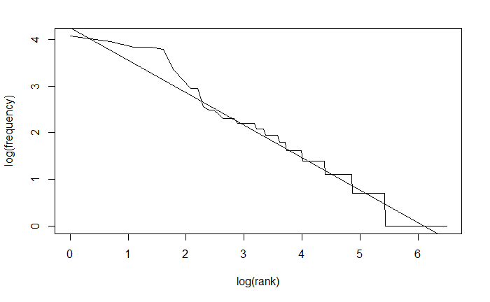
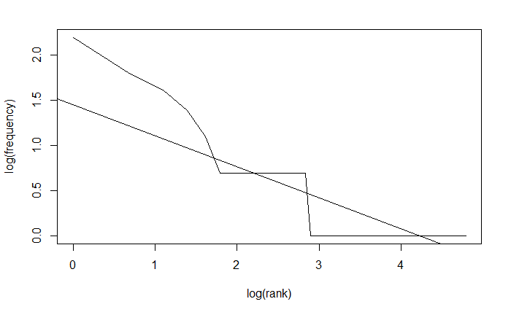
Exploratory Data analysis findings
Why not participate in clinical trials
Why participate in clinical trials

Slide 8
Exploratory data analysis findings
Why not participate in clinical trials
Why participate in clinical trials
Frequent term analysis showed frequent terms that were mostly expected based on the question:
Treatment
Clinical
Trial(s)
Needed
Recurrence
Tumor
Diagnosis
Radiation
Standard
Available
Time
Type
Doctor
Surgery
Options
Qualify
Frequent term analysis showed frequent terms that were expected based on the question:
Treatment
Tumor
Trial

Slide 9
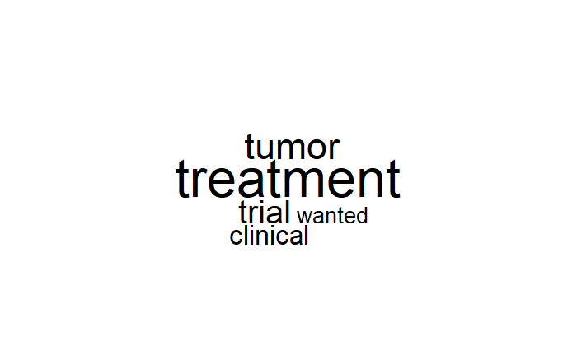
Data visualization for why participate

Slide 10
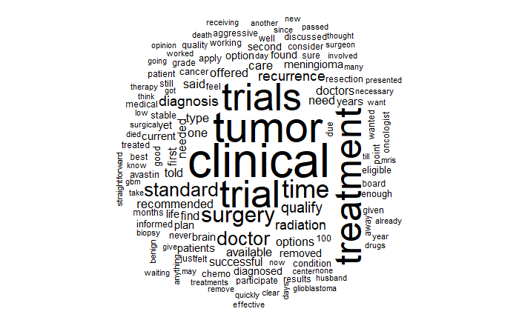
Data visualization for why not participate

Slide 11
methods
Packages
tm
Wordcloud
Topicmodels
SentimentAnalysis
NLP
Rweka
Utilized unsupervised learning to create clusters
LDA modeling
Performed for single words and bigrams
K-means
Performed on single words only
Sentiment analysis
Performed on single words only

Slide 12
Results for why participate
Single word LDA
Bigram LDA
Single word k-means

Slide 13
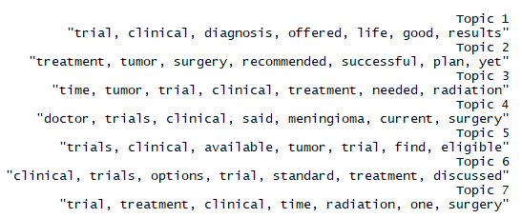
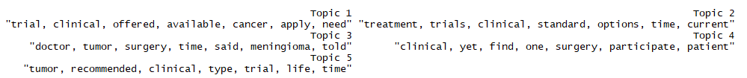
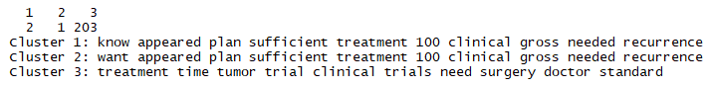
Results for why not participate
Single word LDA
Bigram LDA
Single word k-means

Slide 14
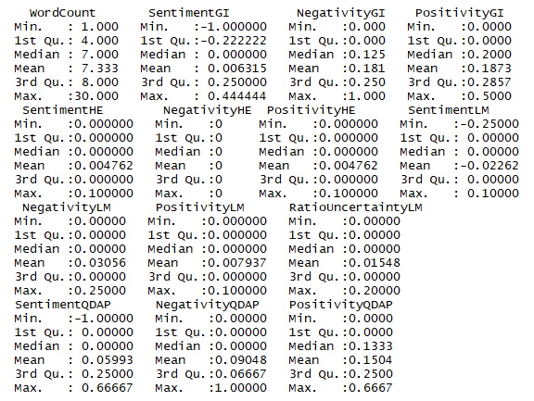
Results for why participate
Based on the sentiment analysis, those who participated in clinical trials had relatively neutral sentiment on the topic

Slide 15
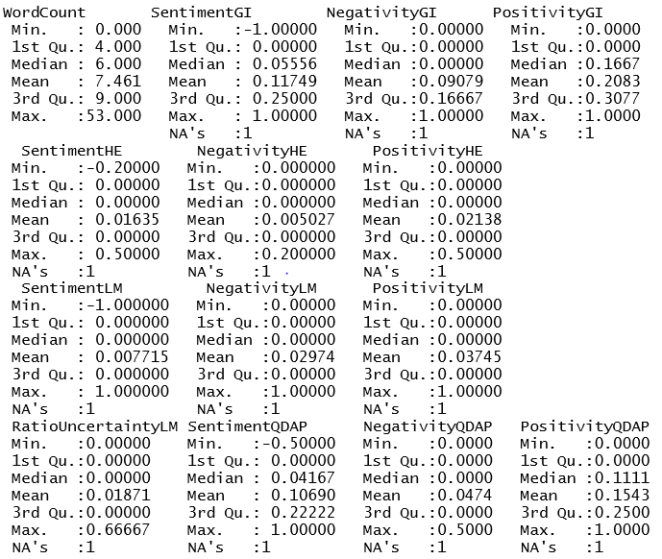
Results for why not participate
Based on the sentiment analysis, those who did not participate in clinical trials had relatively neutral sentiment on the topic

Slide 16
Discussion & conclusions
Larger datasets lead to better clusters
There does not seem to be negative sentiment toward clinical trial participation by brain tumor patients and/or caregivers
This could be due to the respondents being well educated (over 50% held at least a Bachelor’s Degree)
Trial availability, waiting until later in treatment, lack of trial qualification, and feeling that standard treatment was sufficient for their care were the main clusters of reasons to not participate in clinical trials
The only reason that does not align with the assumptions made by the survey design team is the idea that standard treatment was sufficient for their care
Hope, tumor aggressiveness, desperation (likely a lack of other options), and wanting to help others/science were the main reasons for participating in clinical trials
These reasons do align with the assumptions made by the survey design team, but it seems that people wanted a place to tell their story more than having other reasons
In the future, I would like to try to limit cross-over between the clusters to see if that helps create new, more meaningful analysis

